Slide 1
K
N
N
By
S DHANUSH

Slide 2
K
-
N
N
eighbour
earest
By
S DHANUSH

Slide 3
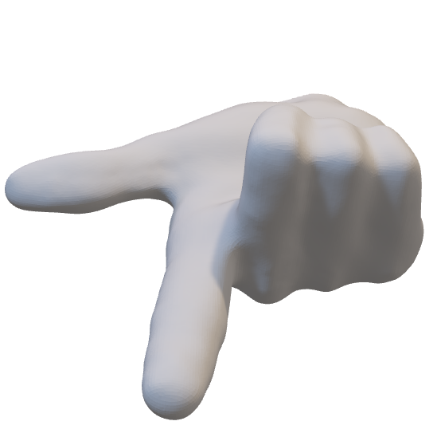
K
-
N
N
eighbour
earest
Welcome
By
S DHANUSH

Slide 4

K
-
N
N
eighbour
earest
Welcome
By
S DHANUSH

Slide 5
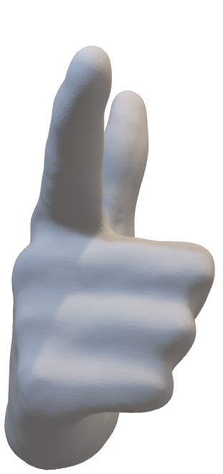
K
-
N
N
eighbour
earest
Welcome
By
S DHANUSH

Slide 6
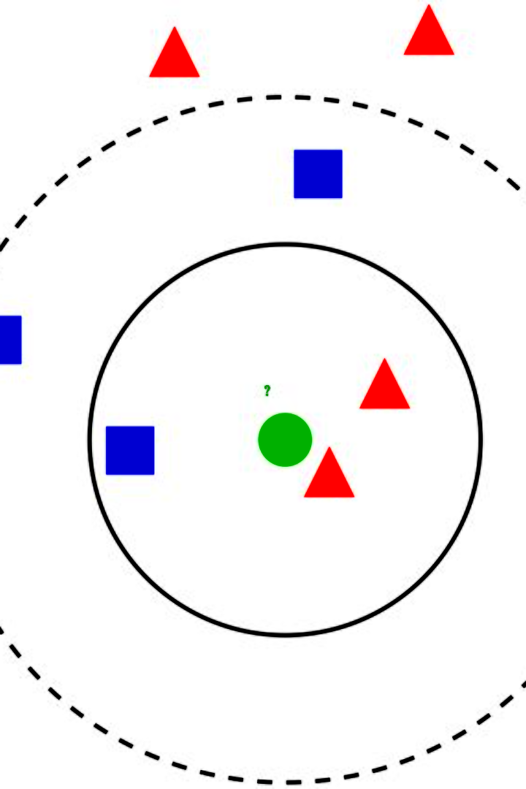
Introduction to k Nearest Neighbor Algorithm
k nearest neighbor (k-NN) algorithm is a supervised learning technique used for classification and regression tasks. It works based on the concept of similarity and proximity among data points.
By
S DHANUSH

Slide 7

Working Principles of k Nearest Neighbor Algorithm
1
Distance Metrics
k-NN algorithm uses various distance metrics, such as Euclidean distance, Manhattan distance, and Minkowski distance, to determine the similarity between data points.
k Value and Decision Making
2
The choice of k determines the number of neighbors to consider. Decision making in k-NN can be based on majority voting in classification tasks or averaging in regression tasks.

Slide 8
Advantages of k Nearest Neighbor Algorithm
Simplicity and Ease of Implementation
Ability to Handle Various Data Types
Non-Parametric Nature
k-NN is easy to understand and implement, making it suitable for beginners in machine learning.
k-NN can handle both numerical and categorical data, making it versatile in different domains.
The non-parametric nature of k-NN allows for greater flexibility in modeling complex relationships in the data.

Slide 9

Challenges and Limitations of k Nearest Neighbor Algorithm
1
Sensitivity to Noisy or Irrelevant Features
2
Computationally Expensive for Large Datasets
k-NN is sensitive to irrelevant or noisy features, leading to less accurate predictions.
As k-NN compares data points to each other, it can be computationally expensive, especially for large datasets.
3
Lack of Interpretability in Results
k-NN provides predictions based on similarities, but it doesn't provide insights into the underlying reasons or relationships.

Slide 10
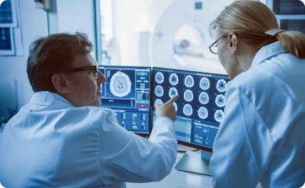
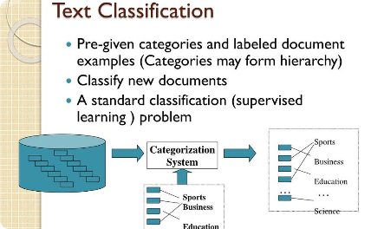
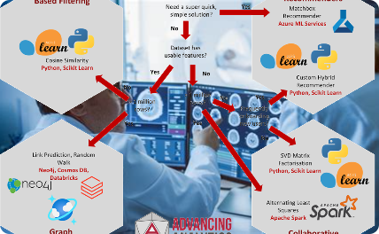
Real-World Applications of k Nearest Neighbor Algorithm
Medical Diagnosis and Disease Prediction
Text Classification and Document Clustering
Recommendation Systems and Collaborative Filtering
k-NN is used in medical fields for disease diagnosis, prediction, and personalized treatments based on similar patient cases.
k-NN is utilized in natural language processing tasks such as sentiment analysis, spam detection, and document categorization.
k-NN plays a role in recommendation systems, providing personalized recommendations based on similar user preferences.

Slide 11
Conclusion: Key Takeaways from the Presentation
k-NN is a versatile algorithm used for classification and regression tasks.
Distance metrics and k value play crucial roles in k-NN.
It has advantages like simplicity, data versatility, and flexibility.
Challenges include sensitivity to noise, computational complexity, and lack of interpretability.
k-NN finds applications in medical diagnosis, text classification, and recommendation systems.

